Slide 1
Multi-objective optimization
Method to optimize a function that might be composed of multiple parameters which might conflict with each other (i.e. optimizing one parameter might lead to an increase in another one). The paper is concerned with this in the context of material choice, although the methods can be extrapolated to material design and material selection.
By optimization in multi-objective functions, it is implicitly assumed to there be a compromise; that is, none of the parameters are optimized, but they are all collectively pushed to their optima as interdependence allows.
Objectives: make the design as cheap as possible, etc.
Constraints: certain dimensions must be fixed, the design must function in a certain range of temperature, etc.
In the selection of a material we are concerned with their performance metrics, denoted by P_{j}. These are related to the control variables (e.g. dimensions of the component, properties, etc.) x_{i} by objective functions. These objective functions are such that the performance is inversely proportional to its value. An example could be: P_{j} = f_{j} [(Loads, F), (Geometry, G), (Material, M)].
Multi-objective optimization aims to optimize multiple performance metrics P₁ , P₂ , …, P_{j} simultaneously given some constraints.

Slide 2
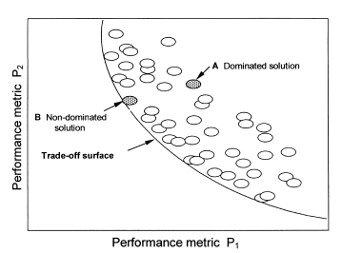
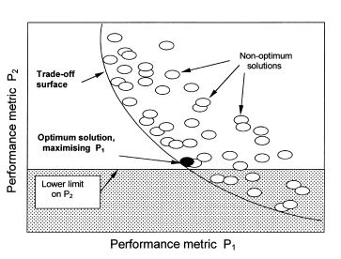

Trade-off surfaces
In the case of multiple objectives, we need to consider trade-off surfaces. We have solutions that are optimal or non-dominated, such as B; and solutions that are non-optimal or dominated, such as A. The set of values for the parameters P_{j} that are optimal is called the Pareto set.
We can set constraints in the performance metrics for an “absolute” optimization solution.
Value function of the form V = α₁P₁ + α₂P₂ + ... + α_{j}P_{j} such that the minimum value for V is the optimum. The values for α are exchange constants and are such that
These constants tend to be derived from technical models.
Cost (C) can be included as a performance metric in the value function.

Slide 3
